Slide 1




Modeling Infection Propagation in Populations
Federico Muscarà Marco Parentin Leonardo Straccali Francesco Zanasi
High Performance Computing Project
Politecnico di Torino

Slide 2
Presentation Overview
Introduction
Solution Description
Experimental Results
Conclusions
1

Slide 3

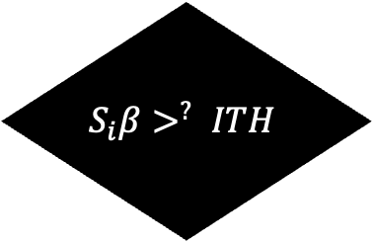
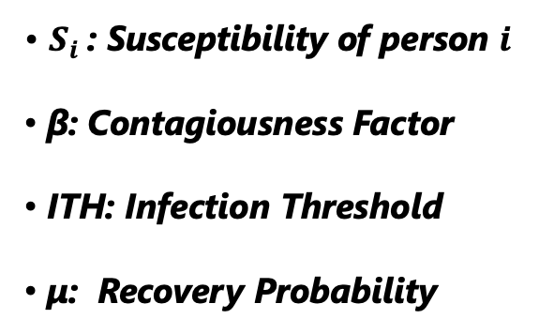
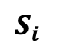
Introduction: The Kermack-McKendrick (SIR) Model
50%
Susceptible
Recovery
Susceptible
μ
50%
Immune
Incubation days
$$S_{i}$$
1-μ
Yes
$$S_{i}β>^{?} ITH$$
$S_{i}$: Susceptibility of person $i$
β: Contagiousness Factor
ITH: Infection Threshold
μ: Recovery Probability
No
Decease
β
Susceptible
Infected
2

Slide 4

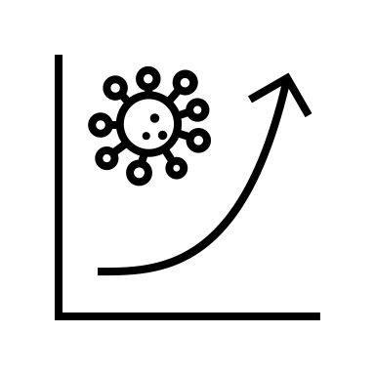

Solution Description: SERIAL Version – Program Organization
Map Initialization
INIT_POPULATION
SIMULATE_ONE_DAY
Disease Spread
Random Uniform Placement
Agent Movement
State Assignment Distribution
State Update
MAIN
3

Slide 5






Solution Description: SERIAL Version – Population Initialization
Our Goal:
PERSON
float susceptibility
int incubation_days
int x,y
CELL
int occupancy
Person ** persons
Each Cell contains at maximum "MAXP_CELL" individuals
4

Slide 6



Solution Description: SERIAL Version – Population Initialization
Tuple List
Generation af all WxH coordinates
Map Initialization
Cells occupancy set to 0
All Person Pointer
Each Cell points to MAXP_CELL slots of All Person Pointer
Occupancy Map
5

Slide 7
Solution Description: SERIAL Version – Population Initialization
Random Placement
Random Coordinate Extraction
Person Addition to Corresponding Cell
PERSON
TUPLE LIST
OCCUPANCY MAP
6

Slide 8
Solution Description: SERIAL Version – Population Initialization
INFP: Initial infected percentage
IMM: Initial immune percentage
Immune: S = 0
State Distribution Assignment
Susceptible: S>0
Infected: Incubation days > 0
7

Slide 9
Solution Description: SERIAL Version – Daily Simulation
Infected agent scanning
Probability-based infection
Disease Spread
Start Daily Iteration
Agent Movement
Random displacement generation
Boundary/occupancy validation
State Update
Incubation completion
Recovery/death probability
8

Slide 10


Solution Description: SERIAL Version – Daily Simulation
Choose An infected Agent
Decrement its Incubation Days
Examine its Moore Neighborhood
For each Neighbor Compute S*β >? Ith
DISEASE
SPREAD
9

Slide 11


Solution Description: SERIAL Version – Daily Simulation
Choose An infected Agent
Decrement its Incubation Days
Examine its Moore Neighborhood
For each Neighbor Compute S*β >? Ith
DISEASE
SPREAD
Newly infected
Incubation_days = -1
10

Slide 12
Solution Description: SERIAL Version – Daily Simulation
Choose a Non-Deceased Agent
Choose One Neighboring Cell
Check Boundaries and Occupancy
Complete the Movement
AGENT MOVEMENT
11

Slide 13


Solution Description: SERIAL Version – Daily Simulation
Choose a Non-Deceased Agent
Choose One Neighboring Cell
Check Boundaries and Occupancy
Complete the Movement
AGENT MOVEMENT
12

Slide 14
Solution Description: SERIAL Version – Daily Simulation
STATE
UPDATE
Choose an Infected with INC = 1
Probability μ: Recover
50% Chance: Immunity
Probabilty 1-μ: Death
13

Slide 15


Solution Description: SERIAL Version – Daily Simulation
STATE
UPDATE
Choose an Infected with INC = 1
Probability μ: Recover
50% Chance: Immunity
Probabilty 1-μ: Death
Newly recovered
Incubation_days = -2
14

Slide 16


Solution Description: OpenMP Version – Program Organization
Map Initialization
INIT_POPULATION
SIMULATE_ONE_DAY
Disease Spread
Random Uniform Placement
Agent Movement
State Assignment Distribution
State Update
MAIN
INIT_LOCKS
DESTROY_LOCKS
15

Slide 17
Solution Description: OpenMP Version – Population Initialization
#pragma omp parallel for collapse(2)
Tuple List
Generation af all WxH coordinates
Map Initialization
All Person Pointer
Cells occupancy set to 0
Each Cell points to MAXP_CELL slots of All Person Pointer
Occupancy Map
16

Slide 18

Solution Description: OpenMP Version – Population Initialization
#pragma omp parallel for
RACE CONDITION
Random Placement
Random Coordinate Extraction
Person Addition to Corresponding Cell
PERSON
TUPLE LIST
OCCUPANCY MAP
17

Slide 19
Solution Description: OpenMP Version – Population Initialization
#pragma omp parallel for
OMP people distribution not aligned with coordinates distribution
Random Placement
Each thread selects its tuples
Person Addition to Corresponding Cell
PERSON
PER-THREAD TUPLE LIST
OCCUPANCY MAP
18

Slide 20
Solution Description: OpenMP Version – Population Initialization
Random Placement
&
State Distribution
Cells per-thread
Infected per-thread
People per-thread
SERIAL PRE-COMPUTATION
Immune per-thread
Cells and People per-thread Offsets
Cell start / end
People start / end
19

Slide 21


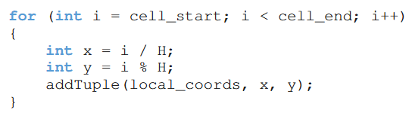

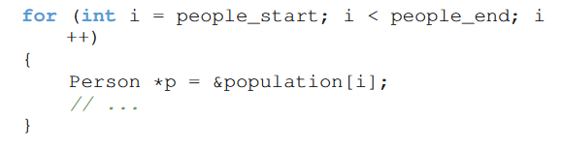

Solution Description: OpenMP Version – Population Initialization
PARALLEL SECTION
Cell start / end
TID 1
Random Placement
&
State Distribution
TID 2
TID 3
People start / end
20

Slide 22


Solution Description: OpenMP Version – Daily Simulation
Disease Spread
CELL LOCKS
Start Daily Iteration
Agent Movement
State Update
Array of "omp_lock_t"
Each lock is associated to a tuple
21

Slide 23
Solution Description: OpenMP Version – Daily Simulation
Choose An infected Agent
Decrement its Incubation Days
Examine its Moore Neighborhood
For each Neighbor Compute S*β >? Ith
TID 1
DISEASE SPREAD
22

Slide 24
Solution Description: OpenMP Version – Daily Simulation
Choose An infected Agent
Decrement its Incubation Days
Examine its Moore Neighborhood
For each Neighbor Compute S*β >? Ith
TID 1
DISEASE SPREAD
23

Slide 25
Solution Description: OpenMP Version – Daily Simulation
Choose An infected Agent
Decrement its Incubation Days
Examine its Moore Neighborhood
For each Neighbor Compute S*β >? Ith
TID 1
DISEASE SPREAD
24

Slide 26
Solution Description: OpenMP Version – Daily Simulation
Choose An infected Agent
Decrement its Incubation Days
Examine its Moore Neighborhood
For each Neighbor Compute S*β >? Ith
TID 1
DISEASE SPREAD
Per-Thread Newly infected
incubation_days = -1
25

Slide 27
Solution Description: OpenMP Version – Daily Simulation
Choose a Non-Deceased Agent
Choose One Neighboring Cell
Check Boundaries and Occupancy
Complete the movement
TID 1
AGENT MOVEMENT
26

Slide 28
Solution Description: OpenMP Version – Daily Simulation
Choose a Non-Deceased Agent
Choose One Neighboring Cell
Check Boundaries and Occupancy
Complete the movement
TID 1
AGENT MOVEMENT
27

Slide 29
Solution Description: OpenMP Version – Daily Simulation
Choose a Non-Deceased Agent
Choose One Neighboring Cell
Check Boundaries and Occupancy
Complete the movement
TID 1
AGENT MOVEMENT
28

Slide 30
Solution Description: OpenMP Version – Daily Simulation
Choose a Non-Deceased Agent
Choose One Neighboring Cell
Check Boundaries and Occupancy
Complete the movement
TID 1
AGENT MOVEMENT
29

Slide 31
Solution Description: OpenMP Version – Daily Simulation
Choose a Non-Deceased Agent
Choose One Neighboring Cell
Check Boundaries and Occupancy
Complete the movement
TID 1
AGENT MOVEMENT
30

Slide 32
Solution Description: OpenMP Version – Daily Simulation
Choose a Non-Deceased Agent
Choose One Neighboring Cell
Check Boundaries and Occupancy
Complete the movement
TID 1
AGENT MOVEMENT
31

Slide 33
Solution Description: SERIAL Version – Daily Simulation
STATE
UPDATE
TID 1
Choose an Infected with INC = 1
Probability μ: Recover
50% Chance: Immunity
Probabilty 1-μ: Death
32

Slide 34
Solution Description: SERIAL Version – Daily Simulation
STATE
UPDATE
TID 1
Choose an Infected with INC = 1
Probability μ: Recover
50% Chance: Immunity
Probabilty 1-μ: Death
Per-thread Newly recovered
Incubation_days = -2
33

Slide 35



Solution Description: OpenMP Version – Daily Simulation
TID 2
TID 1
TID 3
34

Slide 36
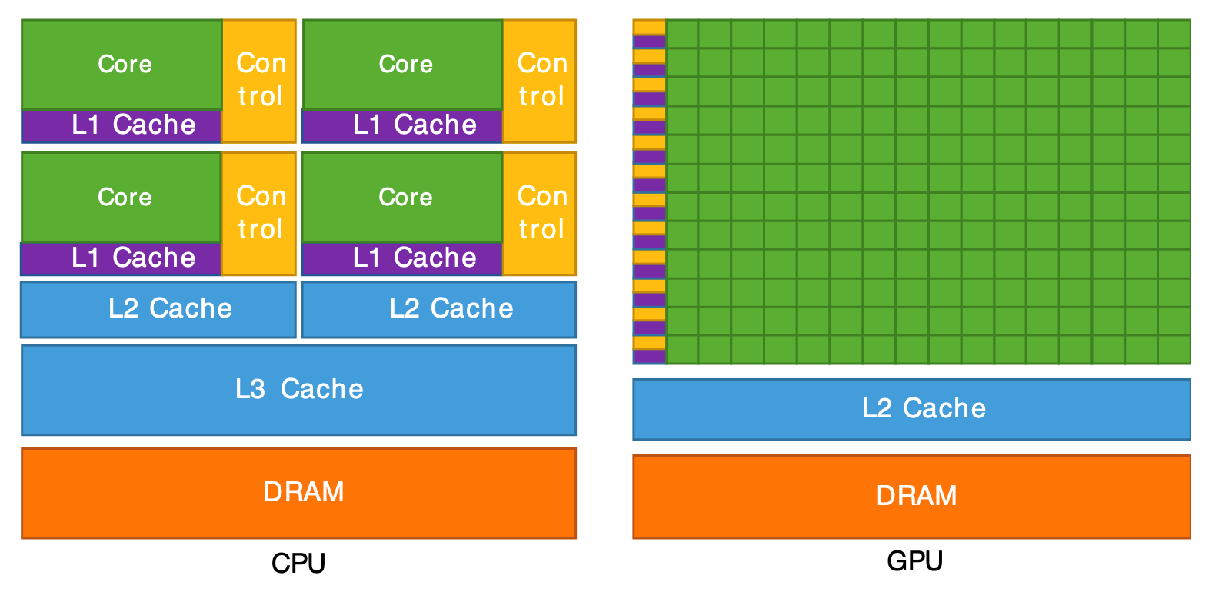
Solution Description: CUDA Version
Change of architecture
35

Slide 37

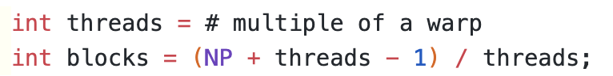
Solution Description: CUDA Version
Thread
Person
=
Grid = Population
36

Slide 38



Solution Description: CUDA Version
On-chip Memory
Off-chip Memory
Block shared memory
Global memory
Fast, Low latency
High latency
small
large
Block
0
Block
34
Global synchronization
Tiling
37

Slide 39
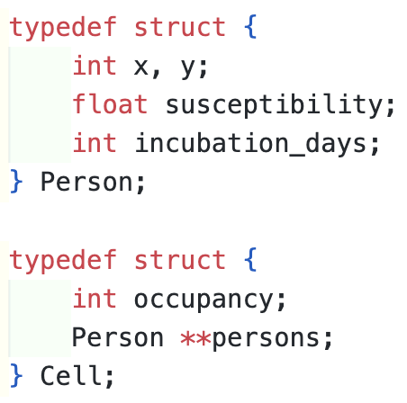
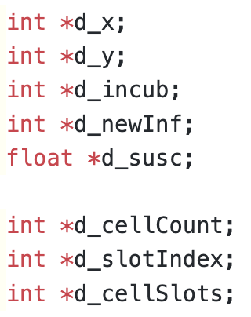

Solution Description: CUDA Version --> Togliere codice, rimettere le icone di slide 6
coalesced memory access
Array Of Structures
Structure of Arrays
38

Slide 40
Solution Description: CUDA Version
Max People per cell = 2
cell count (W*H)
0
1
0
2
1
slot index (NP)
1
2
3
0
0
1
0
cell slots (W*H*MaxP)
0
#
#
#
1
2
3
#
39

Slide 41
Solution Description: CUDA Version
Max People per cell = 2
cell count (W*H)
0
1
0
2
1
slot index (NP)
1
2
3
0
0
1
0
cell slots (W*H*MaxP)
0
#
#
#
1
2
3
#
40

Slide 42
Solution Description: CUDA Version
Max People per cell = 2
cell count (W*H)
0
1
0
2
1
slot index (NP)
1
2
3
0
0
1
0
cell slots (W*H*MaxP)
0
#
#
#
1
2
3
#
41

Slide 43
Solution Description: CUDA Version
Max People per cell = 2
cell count (W*H)
0
1
0
2
1
slot index (NP)
1
2
3
0
0
1
0
cell slots (W*H*MaxP)
0
#
#
#
1
2
3
#
42

Slide 44
Solution Description: CUDA Version
Max People per cell = 2
cell count (W*H)
0
1
1
0
2
1
slot index (NP)
old Slot index
2
3
0
0
1
0
0
cell slots (W*H*MaxP)
0
#
1
#
1
2
3
#
43

Slide 45
Solution Description: CUDA Version
Max People per cell = 2
cell count (W*H)
0
1
1
1
1
1
slot index (NP)
old Slot index
2
3
0
0
0
0
0
cell slots (W*H*MaxP)
0
#
1
#
1
2
3
#
44

Slide 46
Solution Description: CUDA Version
Max People per cell = 2
cell count (W*H)
0
1
1
1
1
1
slot index (NP)
old Slot index
2
3
0
0
0
0
0
cell slots (W*H*MaxP)
0
#
1
#
2
#
3
#
45

Slide 47



Solution Description: CUDA Version
Infection kernel
status update kernel
movement kernel
46

Slide 48
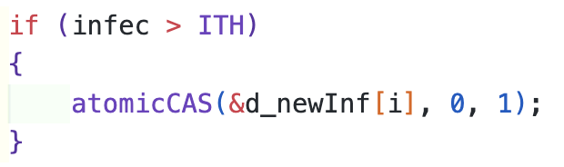

Solution Description: CUDA Version
Infection kernel
status update kernel
movement kernel
47

Slide 49
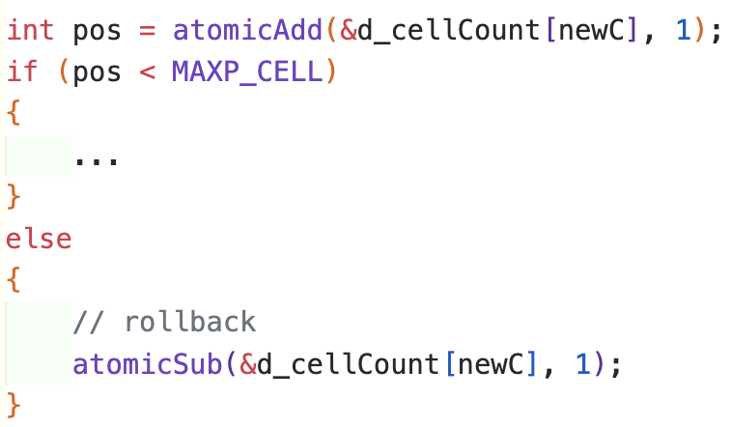
Solution Description: CUDA Version
Infection kernel
status update kernel
movement kernel
48

Slide 50
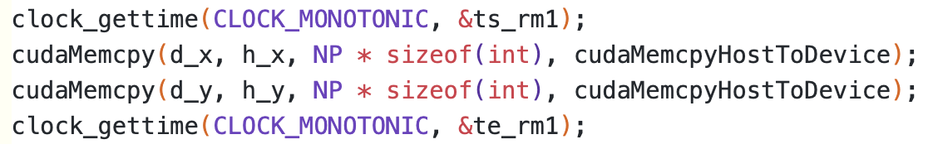
Solution Description: CUDA Version
all data structures are on device except for
we expect
Cuda ≅ Cuda Evo
49

Slide 51
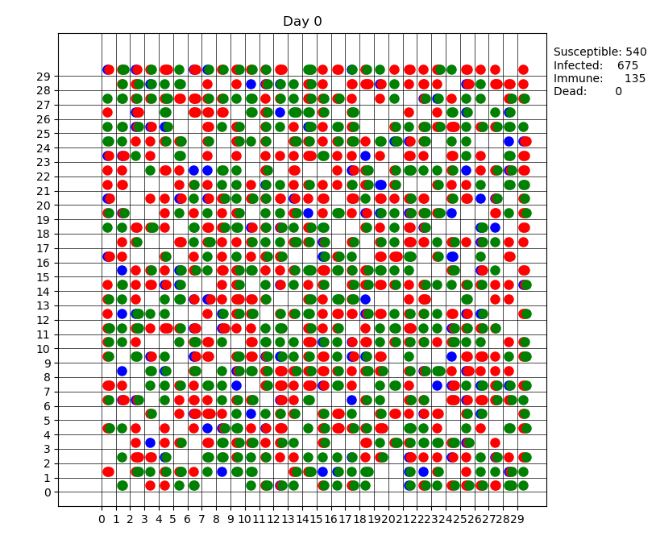
Solution Description: Report
Report of the simulation for each day
Saving data about state and positions
Saving data to binary files: implementation-agnostic manner
50

Slide 52
Solution Description: Report
Unit test
cell occupancy limit
deaths never decrease
initial immune and infected counts
incubation duration and transition
cell movement
state counts sum to NP
positions valid or dead
entries per day
51

Slide 53

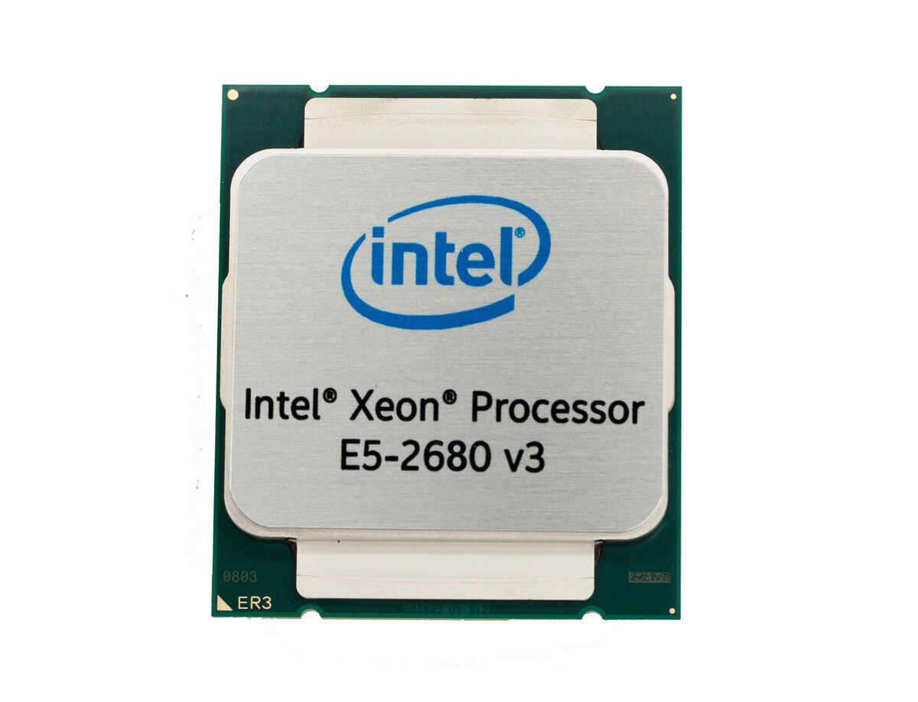
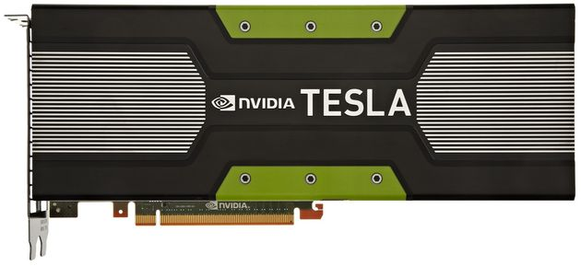

Experimental Results: Platform
HPC Polito (Hactar)
CPU Node: 2x Xeon E5-2680 v3 2.50 GHz (turbo 3.3 GHz) 12 cores
GPU Node: 2x Tesla K40 – 12GB – 2880 cuda cores
Job Scheduler: SLURM
52

Slide 54
Experimental Results: Simulation File Generation
Study performance of the three implementations with increasing input dimension: Serial, OpenMP and Cuda
Set Parameters of simulation
W, NP
Generate parametrized SLURM job
Export number of threads (OMP) and compile
Repeat for t_i in RUNS
Execute
53

Slide 55
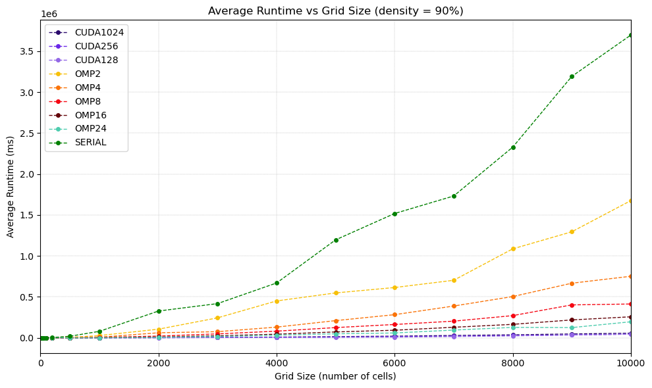
Experimental Results: Performance Analysis
DATASET:
RUNS: 10
Logical parameters: default values
Grid Sizes: from 10x10 to 10000x10000
Population Densities: 0.1, 0.5 and 0.9
OPENMP:
Number of Threads = {2, 4, 8, 16, 24}
CUDA:
Number of Threads per Block = {128, 256, 1024}
54

Slide 56
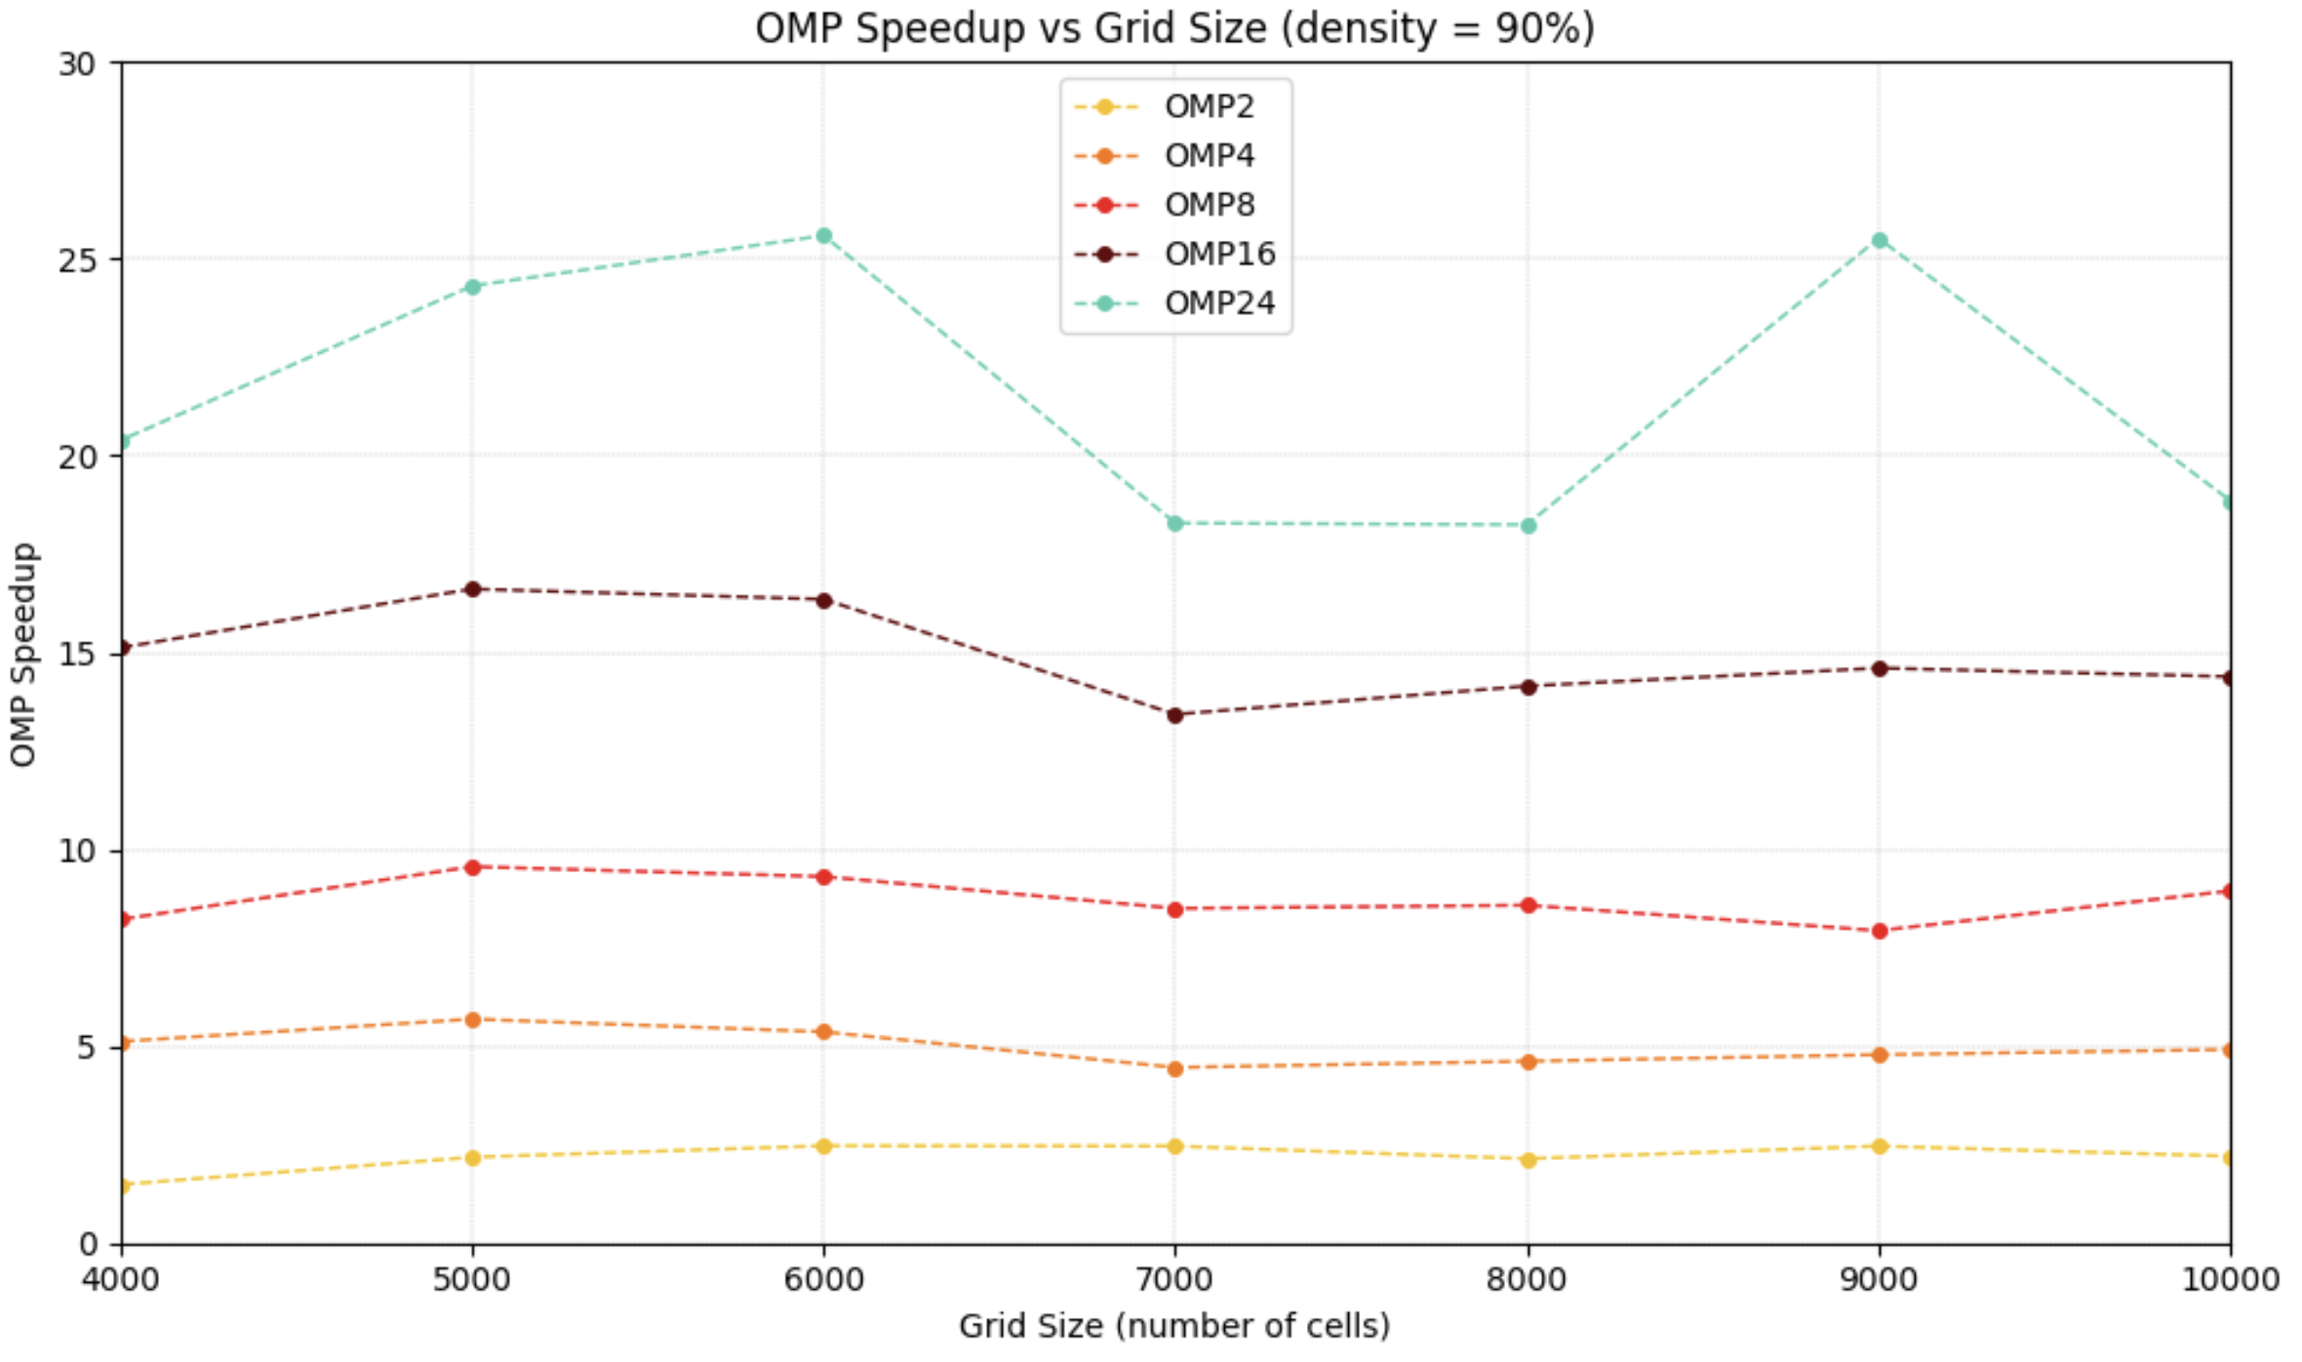
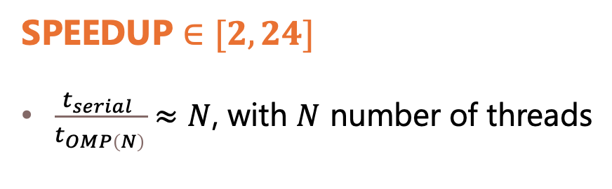
Experimental Results: Speedup - OpenMP
SPEEDUP $∈[2, 24]$
$\frac{t_{serial} }{t_{OMP\left(N\right)}}≈N$, with $N$ number of threads
55

Slide 57
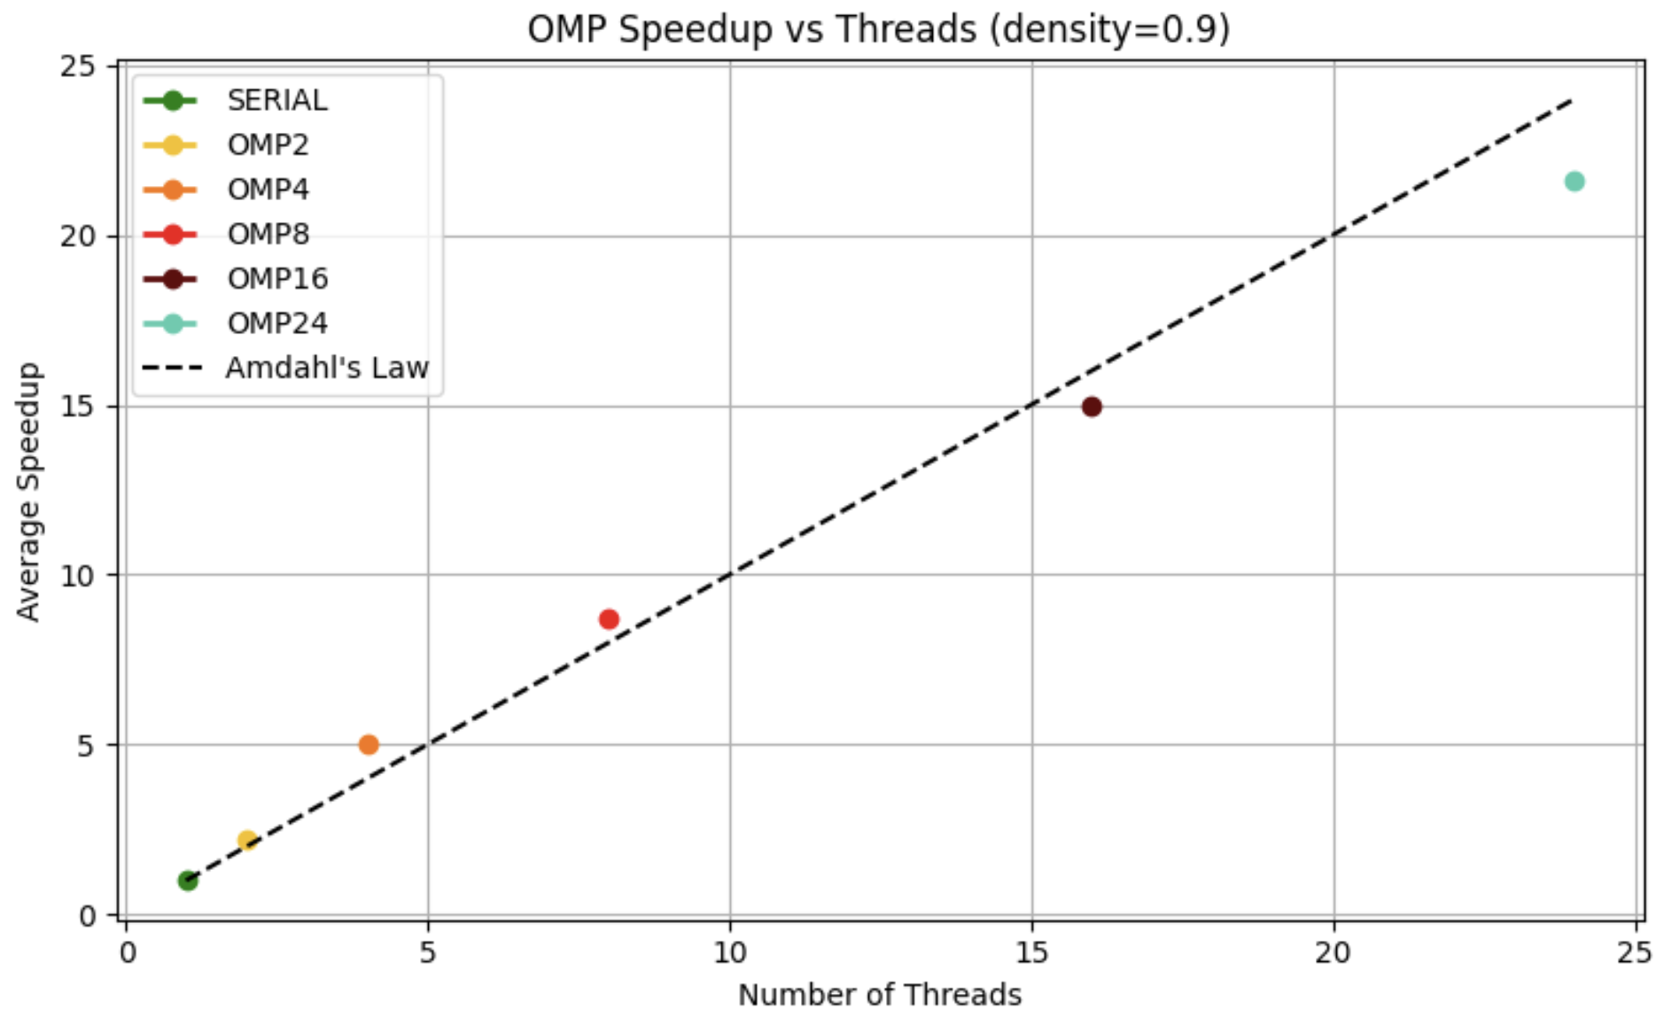
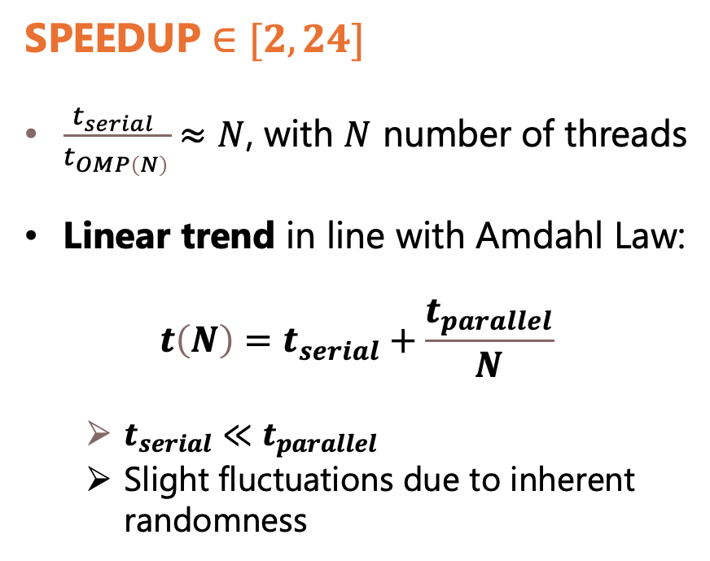
Experimental Results: Speedup - OpenMP
SPEEDUP $∈[2, 24]$
$\frac{t_{serial} }{t_{OMP\left(N\right)}}≈N$, with $N$ number of threads
Linear trend in line with Amdahl Law:
$$t\left(N\right)=t_{serial}+\frac{t_{parallel}}{N}$$
$t_{serial}≪t_{parallel}$
Slight fluctuations due to inherent randomness
56

Slide 58
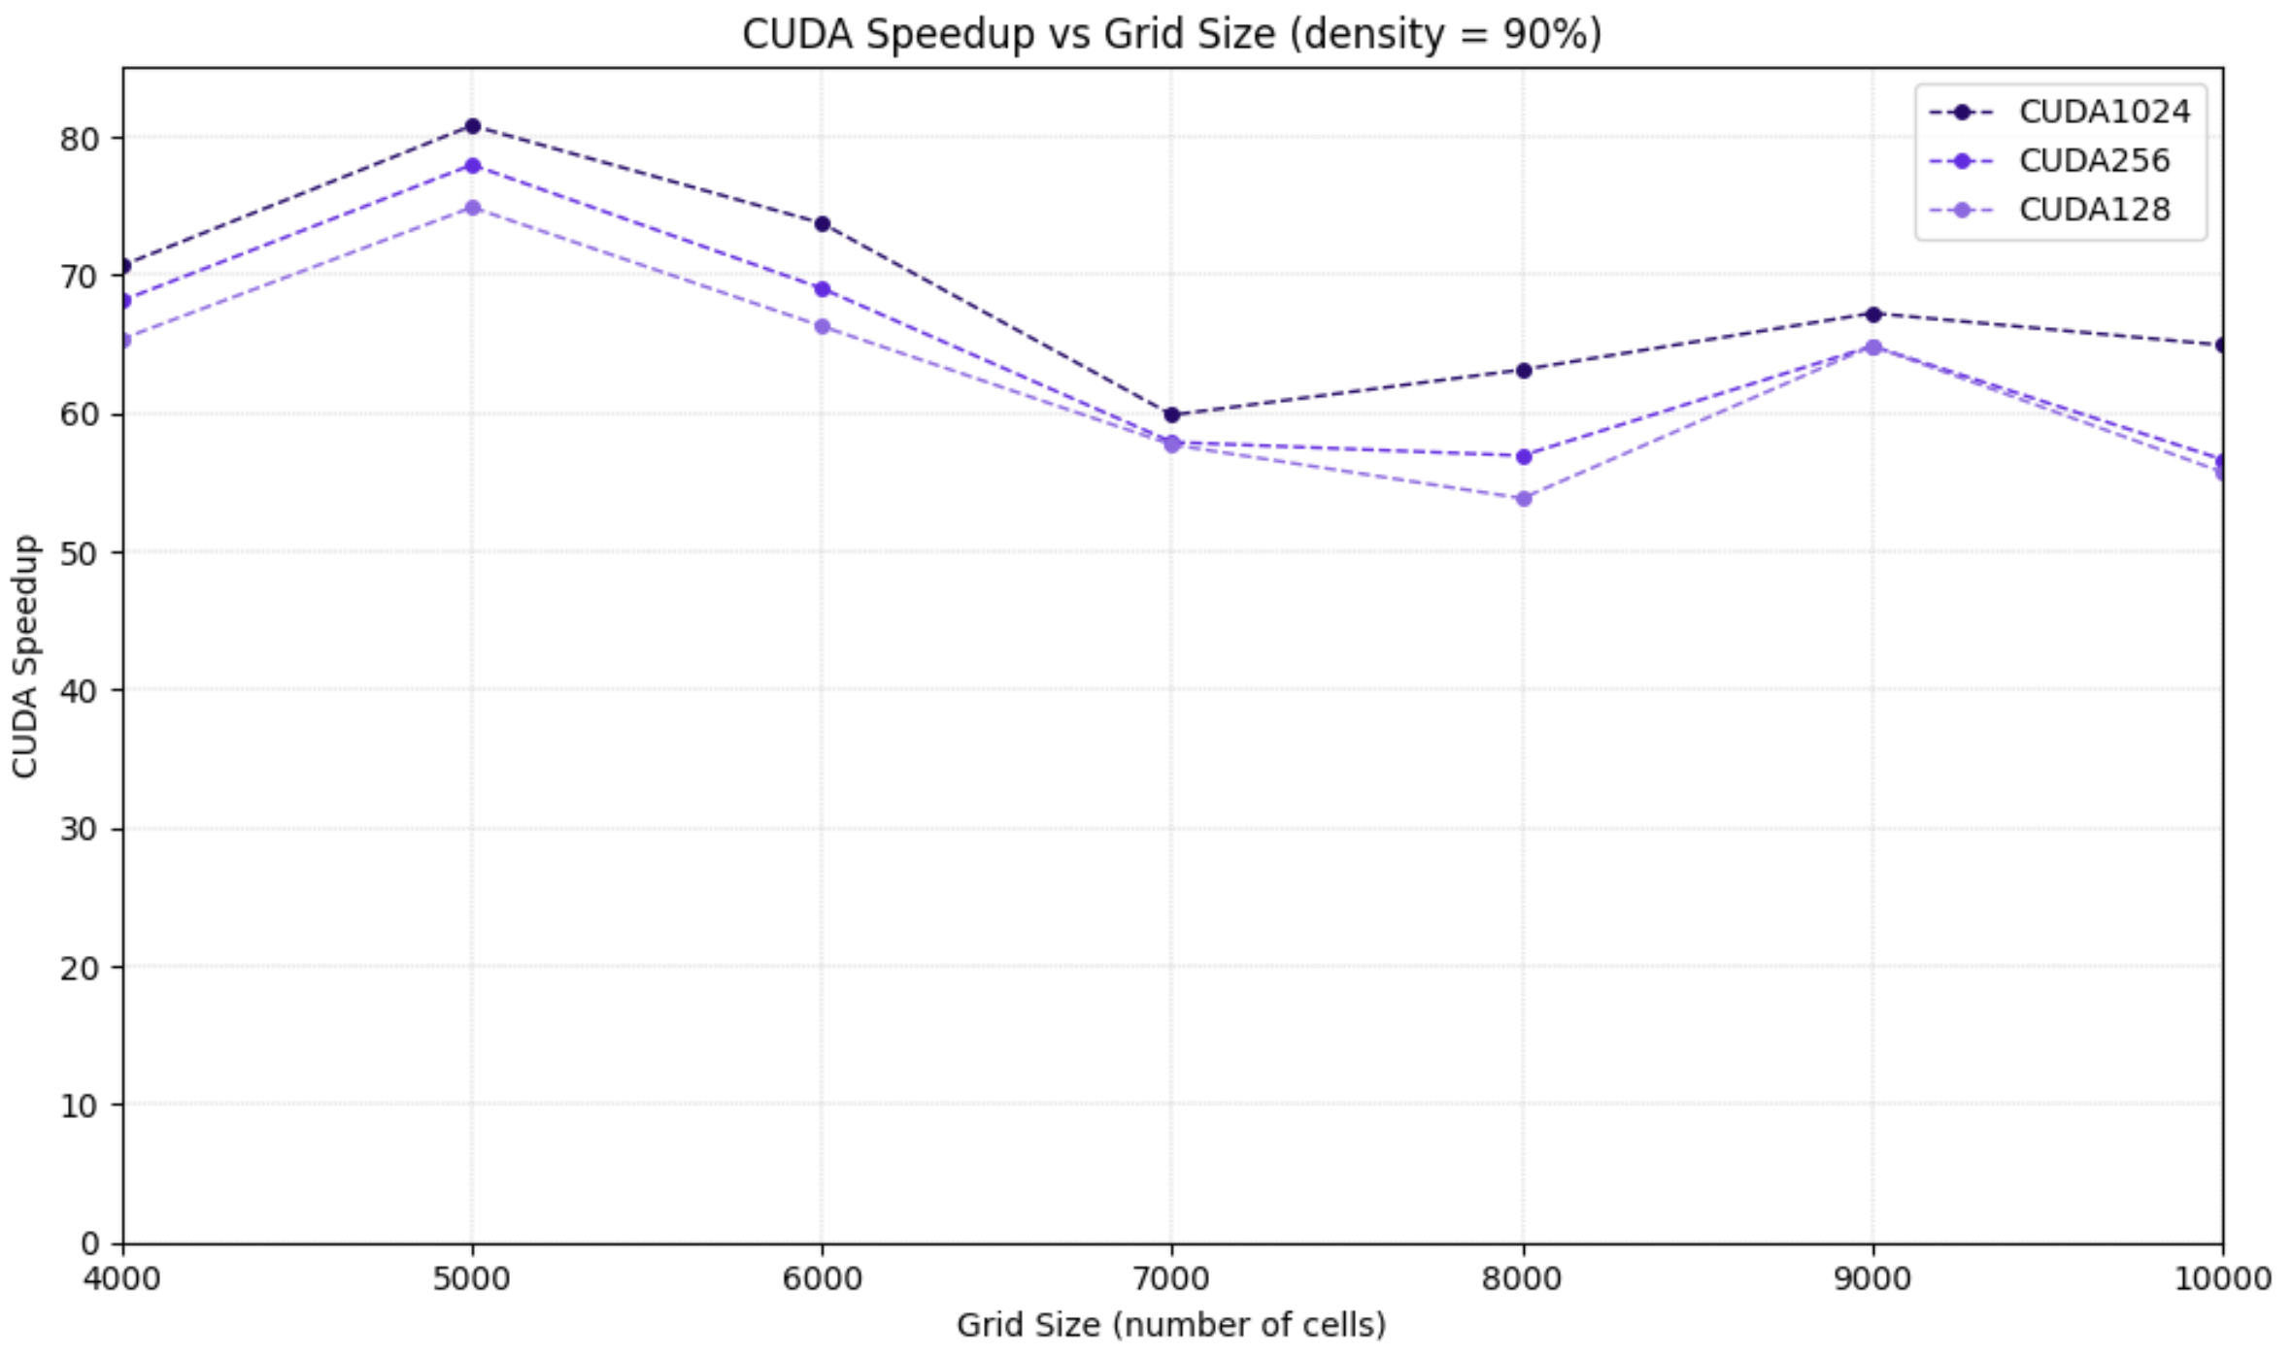
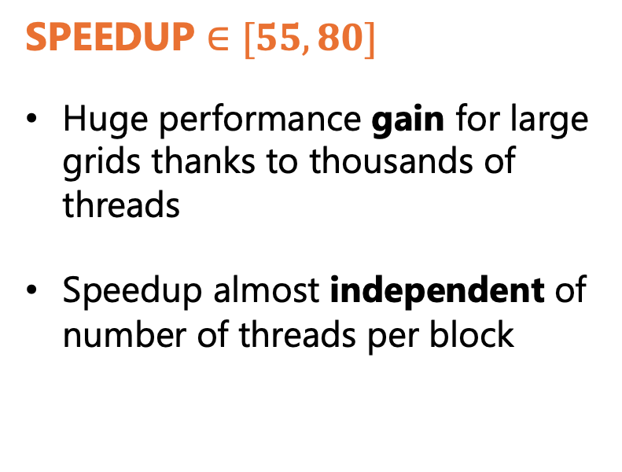
Experimental Results: Speedup - CUDA
SPEEDUP $∈[55, 80]$
Huge performance gain for large grids thanks to thousands of threads
Speedup almost independent of number of threads per block
57

Slide 59
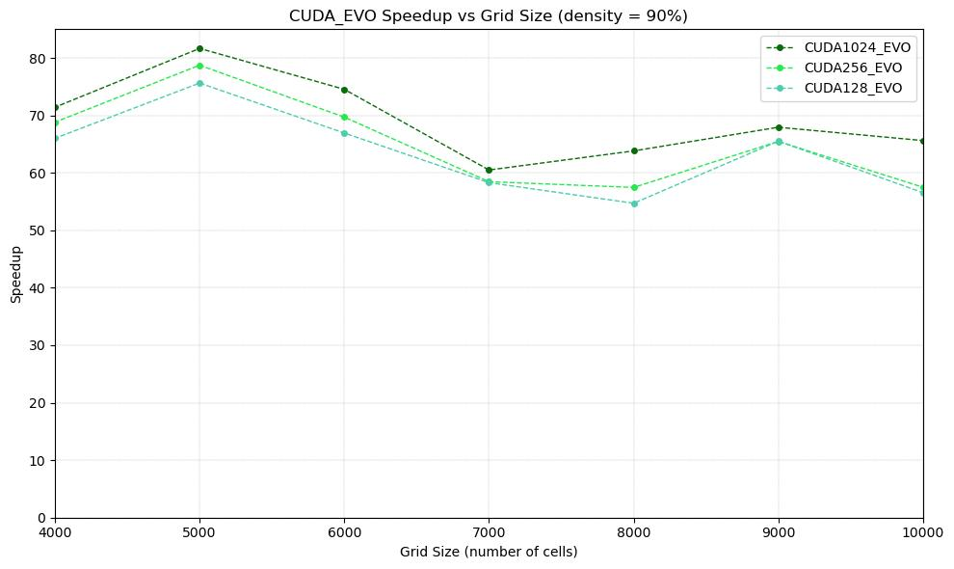
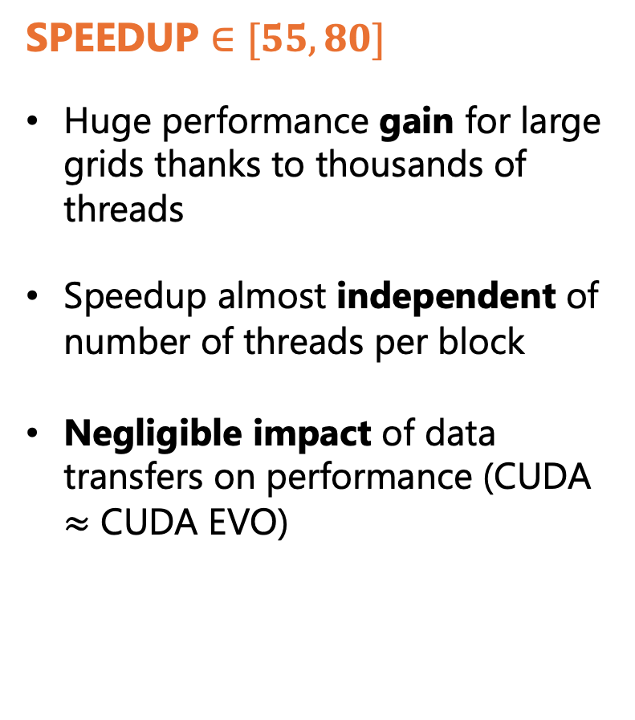
Experimental Results: Speedup - CUDA
SPEEDUP $∈[55, 80]$
Huge performance gain for large grids thanks to thousands of threads
Speedup almost independent of number of threads per block
Negligible impact of data transfers on performance (CUDA $≈$ CUDA EVO)
58

Slide 60
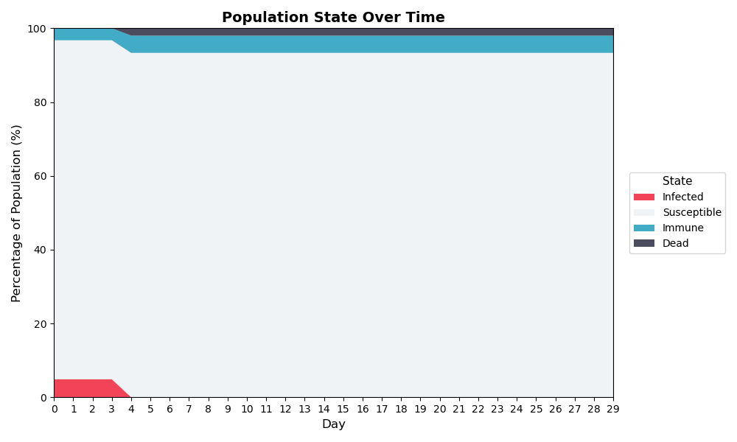
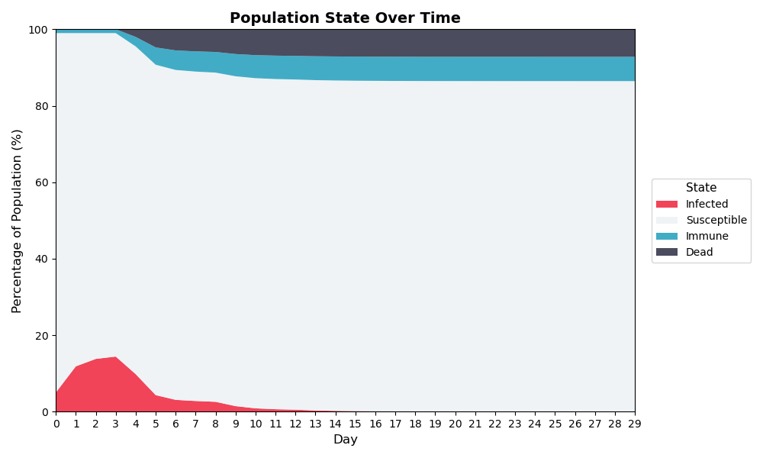
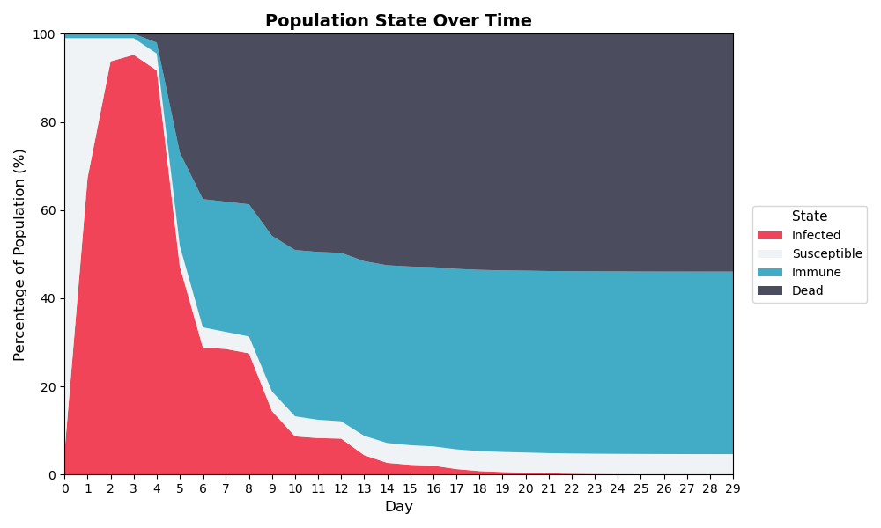
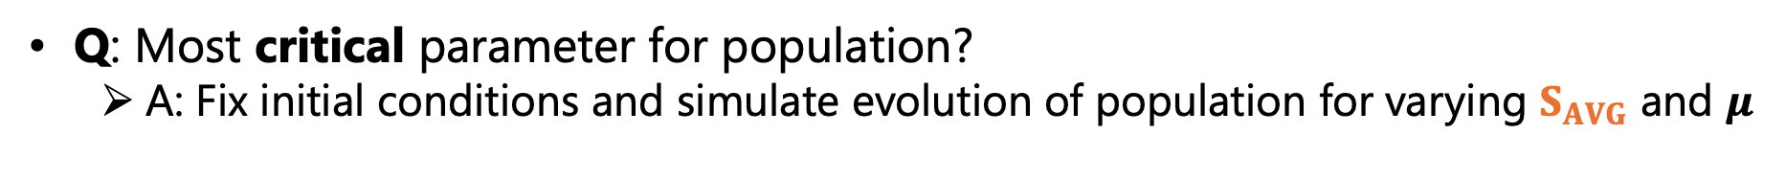
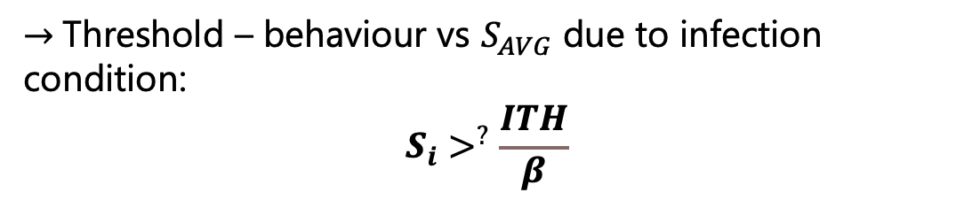
Experimental Results: Logical Simulation
Q: Most critical parameter for population?
A: Fix initial conditions and simulate evolution of population for varying $S_{AVG}$ and $μ$
$S_{AVG}=0.3, μ=0.6$
$S_{AVG}=0.6, μ=0.6$
$S_{AVG}=0.9, μ=0.6$
$→$Threshold – behaviour vs $S_{AVG}$ due to infection condition:
$$S_{i}>^{?}\frac{ITH}{β}$$
59

Slide 61
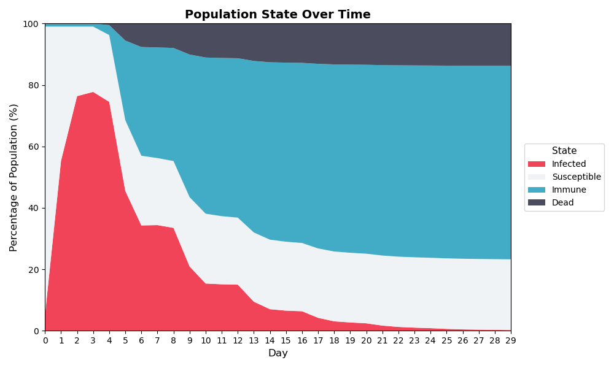
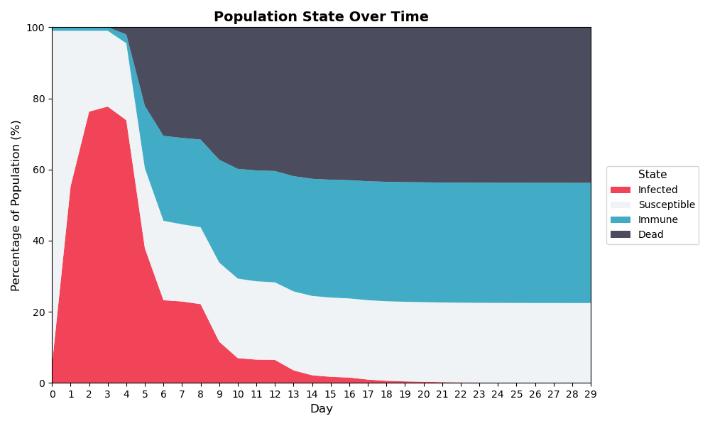
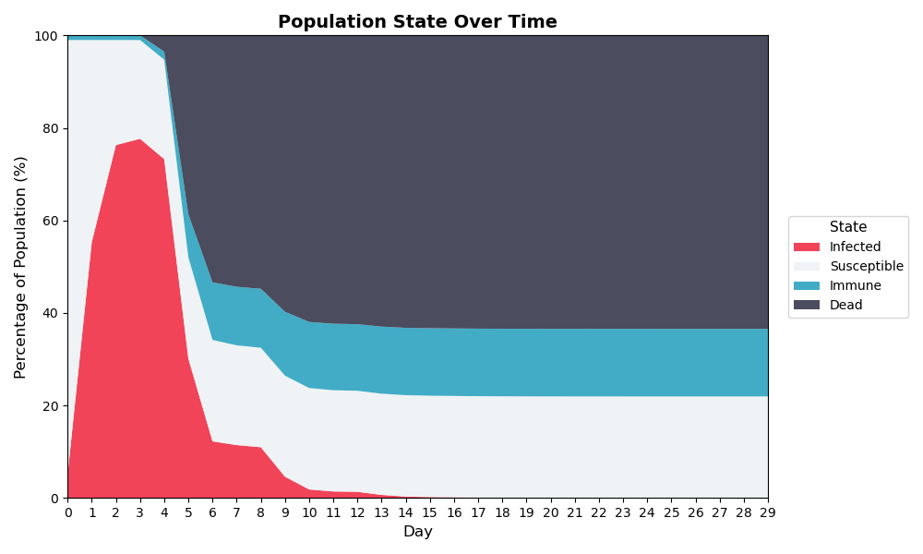
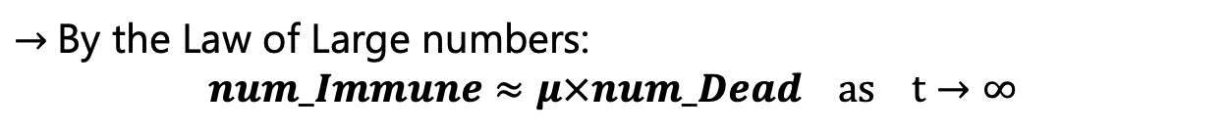
Experimental Results: Logical Simulation
Q: Most critical parameter for population?
A: Fix initial conditions and simulate evolution of population for varying $S_{AVG}$ and $μ$
$S_{AVG}=0.7, μ=0.9$
$S_{AVG}=0.7, μ=0.6$
$S_{AVG}=0.7, μ=0.3$
$→$By the Law of Large numbers:
$$num_Immune≈μ×num_Dead as t→∞$$
60

Slide 62
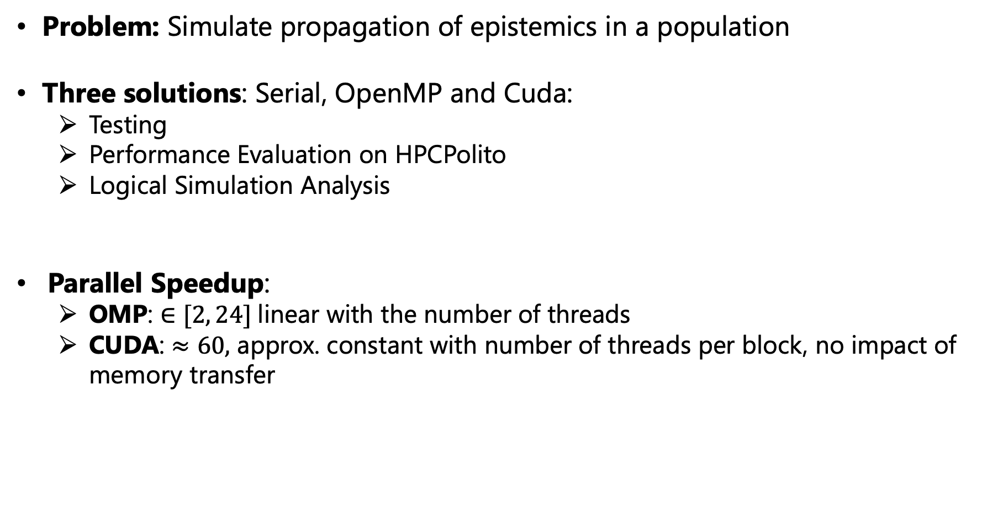
Conclusions
Problem: Simulate propagation of epistemics in a population
Three solutions: Serial, OpenMP and Cuda:
Testing
Performance Evaluation on HPCPolito
Logical Simulation Analysis
Parallel Speedup:
OMP: $∈[2, 24]$linear with the number of threads
CUDA: $≈60,$ approx. constant with number of threads per block, no impact of memory transfer
61
Notes:
Sharpness of the threshold behaviour depends on the standard deviation of the gaussian distribution

Slide 63
Thank you for your attention!
Federico Muscarà Marco Parentin Leonardo Straccali Francesco Zanasi
62
Notes:
Sharpness of the threshold behaviour depends on the standard deviation of the gaussian distribution

Slide 64
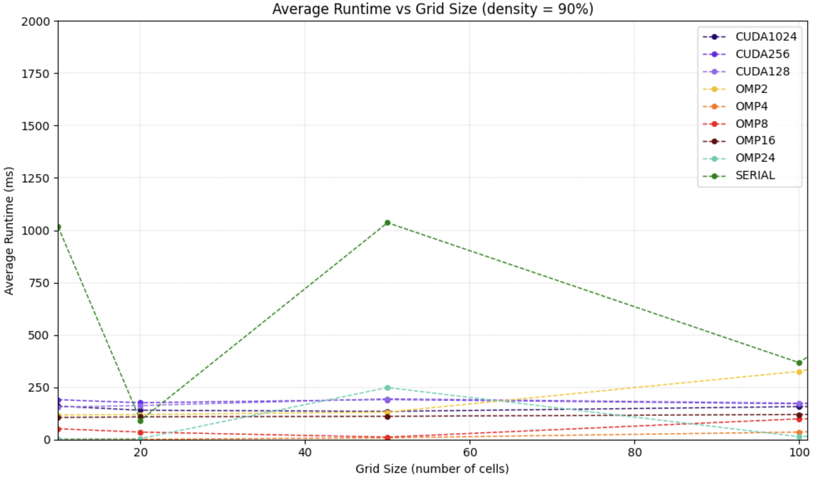
Experimental Results: Performance Analysis
DATASET:
Runs: 10
Grid Sizes: from 10x10 to 10000x10000
Population Densities: 0.1, 0.5 and 0.9
OPENMP
Number of threads = [2, 4, 8, 16, 24]
CUDA
Number of threads per Block = [128, 256, 1024]
54

Slide 65
BACKUP SLIDES
66
Notes:
Sharpness of the threshold behaviour depends on the standard deviation of the gaussian distribution

Slide 66
Experimental Results: Simulation File Generation
Study performance of the three implementations with increasing input dimension: Serial, OpenMP and Cuda
Set Parameters of simulation
W, NP
Generate parametrized SLURM job
run_serial_W${W}_NP${NP}.sh
run_OMP_n_threads_W${W}_NP${NP}.sh
run_CUDA_n_threads_W${W}_NP${NP}.sh
Export number of threads (OMP) and compile
plague_\${W}_\${NP}
plagueMP_n_threads_\${W}_\${NP}
plagueCUDA_\${W}_\${NP}
Repeat for t_i in RUNS
Execute
run\${t_i}.out
52

Slide 67
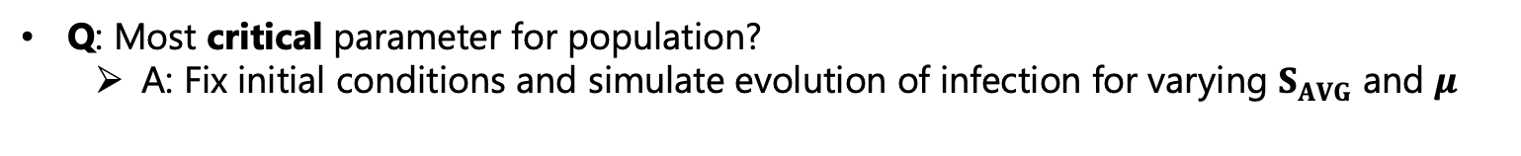
Experimental Results: Logical Simulation
Q: Most critical parameter for population?
A: Fix initial conditions and simulate evolution of infection for varying $S_{AVG}$ and $μ$
$S_{AVG}=0.3, μ=0.6$
$S_{AVG}=0.6, μ=0.6$
$S_{AVG}=0.9, μ=0.6$
61

Slide 68
Experimental Results: Logical Simulation
Q: Most critical parameter for population?
A: Fix initial conditions and simulate evolution of infection for varying $S_{AVG}$ and $μ$
$S_{AVG}=0.7, μ=0.9$
$S_{AVG}=0.7, μ=0.3$
$S_{AVG}=0.7, μ=0.6$
62

Slide 69
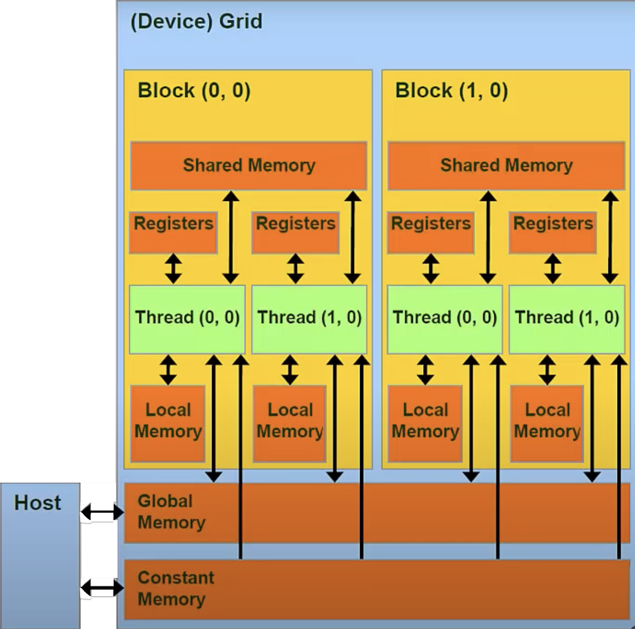
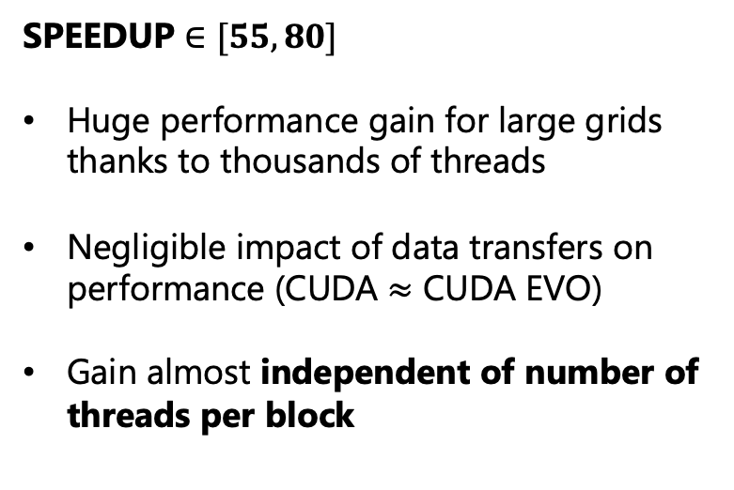
Experimental Results: Speedup - CUDA
SPEEDUP $∈[55, 80]$
Huge performance gain for large grids thanks to thousands of threads
Negligible impact of data transfers on performance (CUDA $≈$ CUDA EVO)
Gain almost independent of number of threads per block
cell count, slot index, cell slots, …
60

Slide 70
Experimental Results: Speedup - CUDA
SPEEDUP $∈[55, 80]$
Huge performance gain for large grids thanks to thousands of threads
Negligible impact of data transfers on performance (CUDA $≈$ CUDA EVO)
Gain almost independent of number of threads per block
59

